Slide 1

Prometheus, Jaeger, and Istio:
Observability for Today’s Enterprises
Notes:
DevOps tool tax
A workflow will help a lot
Maybe rename Envoy to Istio?

Slide 2



About Me
Priyanka Sharma
Director of Cloud Native, GitLab Contributor, OpenTracing
@pritianka
psharma@gitlab.com

Slide 3



Special thanks to
Cindy Sridharan, Observability Badass (Apple)
Richard Hartman, OpenMetrics
Ted Young, OpenTracing

Slide 4
Why should you care about observability?

Slide 5
Speeding Up Release Cycle Time is Critical
Cycle time compression may be the most underestimated force in determining winners & losers in tech.
What you initially thought the goal was
— Marc Andreessen
What the initial optimal solution was
Optimal solution moved to
Notes:
Seven years ago Marc Andreesen said that “Software is eating the world” when he observed that every successful company is reliant on software.
More recently, and arguably more useful, he stated “Cycle time compression may be the most underestimated force in determining winners & losers in tech.”
This is because each iteration gives you an opportunity to deliver real value to our customers. If you are off track, you learn about it quickly, before significant investments are made that take you down the wrong path.
Given we’re all here today, I doubt this is news.
So then, competitiveness depends on how fast teams can deliver code, which is to say how quickly we can create customer value.
Software is accelerating the rate of innovation in all industries, increasing competitiveness and making it possible for competitors to emerge faster than ever before.
Every executive leader knows software is powering their business and is critical to success.
Product development teams have been adopting new methodologies to help them iterate faster.
Specifically we’ve seen Waterfall teams adopt Agile practices to better respond to the dynamic and moving needs of the business.
And then DevOps which promises to solve the slow and error prone process that IT has been trying to deal with.

Slide 6


Business survival depends upon a radically faster
DevOps lifecycle

Slide 7
Thesis for Today’s Talk
The open source ecosystem is teaming with projects related to observability. It is imperative to understand the top projects and develop a framework for utilizing them together for a cohesive observability strategy that meets business goals.
~ Yours Truly :-)

Slide 8
What is Observability?

Slide 9
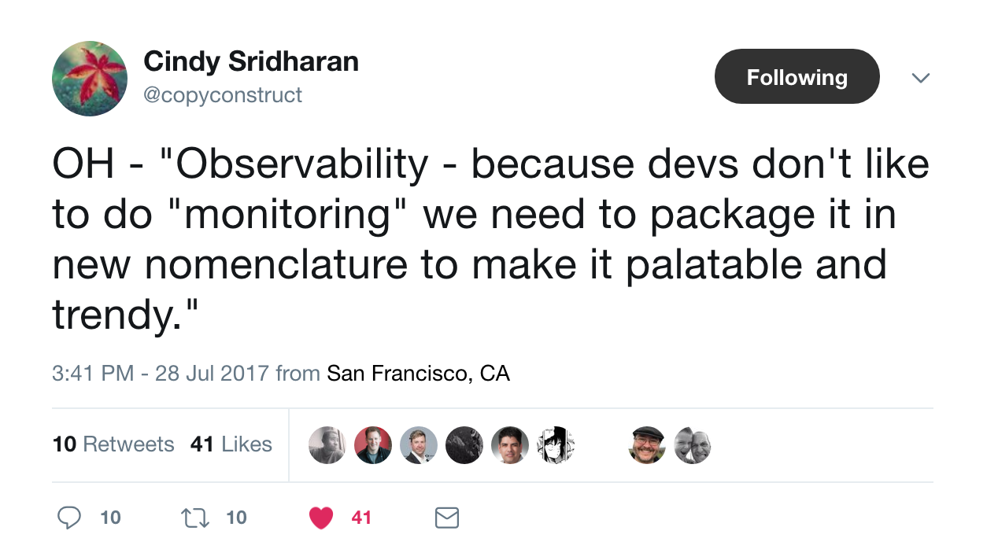
Definitions: Observability

Slide 10
Definitions: Observability
Observability is a superset of monitoring and consists of four pillars that should help us reason about and respond to modern software systems:
- Monitoring
- Alerting/visualization
- Distributed systems tracing infrastructure
- Log aggregation/analytics
~ Yours Truly :-)
Build your own definition: https://medium.com/@copyconstruct/monitoring-and-observability-8417d1952e1c

Slide 11
Why aren’t we at peak performance?

Slide 12
DevOps and Observability have not done as well as expected
$3.9B
spent on DevOps software
>50%
DevOps time wasted on logistics & repeatable tasks
87%
organizations are disappointed with results of DevOps
Notes:
Despite $3.9B having been spent on DevOps software last year, more than half of time spent on DevOps is wasted on logistics and repeatable tasks. although some aspects of the lifecycle have been automated, it’s not moving the dial. In fact, almost 90% of the organizations that have already adopted DevOPs are disappointed with the results according to a 2017 Gartner report.
While improvement have been made for specific KPIs like deployment frequency and change failure rate. Ultimately, the full transformation promise of DevOps has not yet been realized. Even though we’ve implemented DevOps, it’s not working how it should. Why is that?
$3.9B
Source: https://www.idc.com/getdoc.jsp?containerId=US42656318
"In 2017, the worldwide DevOps software market exceeded $3.8 billion for the first time and is on track to undoubtedly surpass $4 billion in 2018," explains Jim Mercer, research director, DevOps at IDC. "The market is currently highly fragmented. There are dozens of vendors competing to offer compelling solutions to better integrate, automate, scale, test, release, and optimize DevOps processes for a wide range of applications and industries."
>50%
https://it.toolbox.com/blogs/craigborysowich/project-management-lite-distribution-of-effort-by-phase-sdlc-031612
87%
87% of the organizations that implement DevOps processes today are already disappointed. - Gartner, May 2017
http://searchitoperations.techtarget.com/feature/Scale-up-DevOps-processes-against-the-odds

Slide 13

Today’s toolchain
limits a faster DevOps lifecycle
Notes:
Well, the reason why the full transformational promise of devops is not being realized is because of the very toolchain we are using to try to accelerate. In fact, today’s toolchain is limiting a faster devops lifecycle.
“Today’s Application Delivery Tool Chain Is Complex And Fragmented” - Forrester
https://www.forrester.com/report/The+Quest+For+SpeedPlusQuality+Drives+Agile+And+DevOps+Tool+Selection/-/E-RES122555

Slide 14
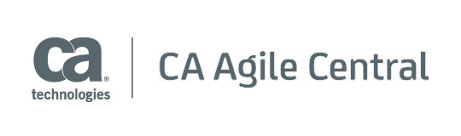
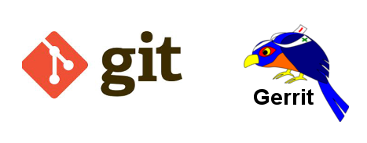

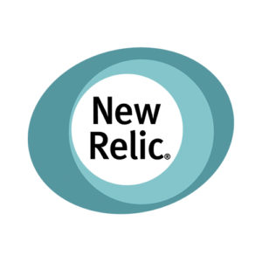




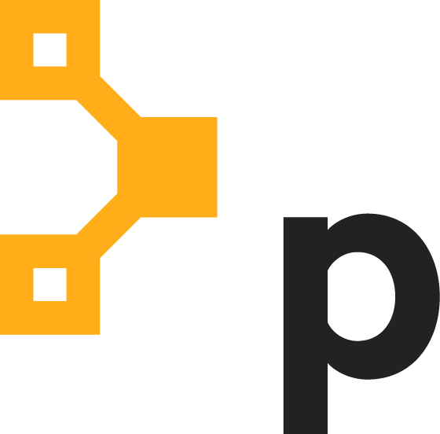
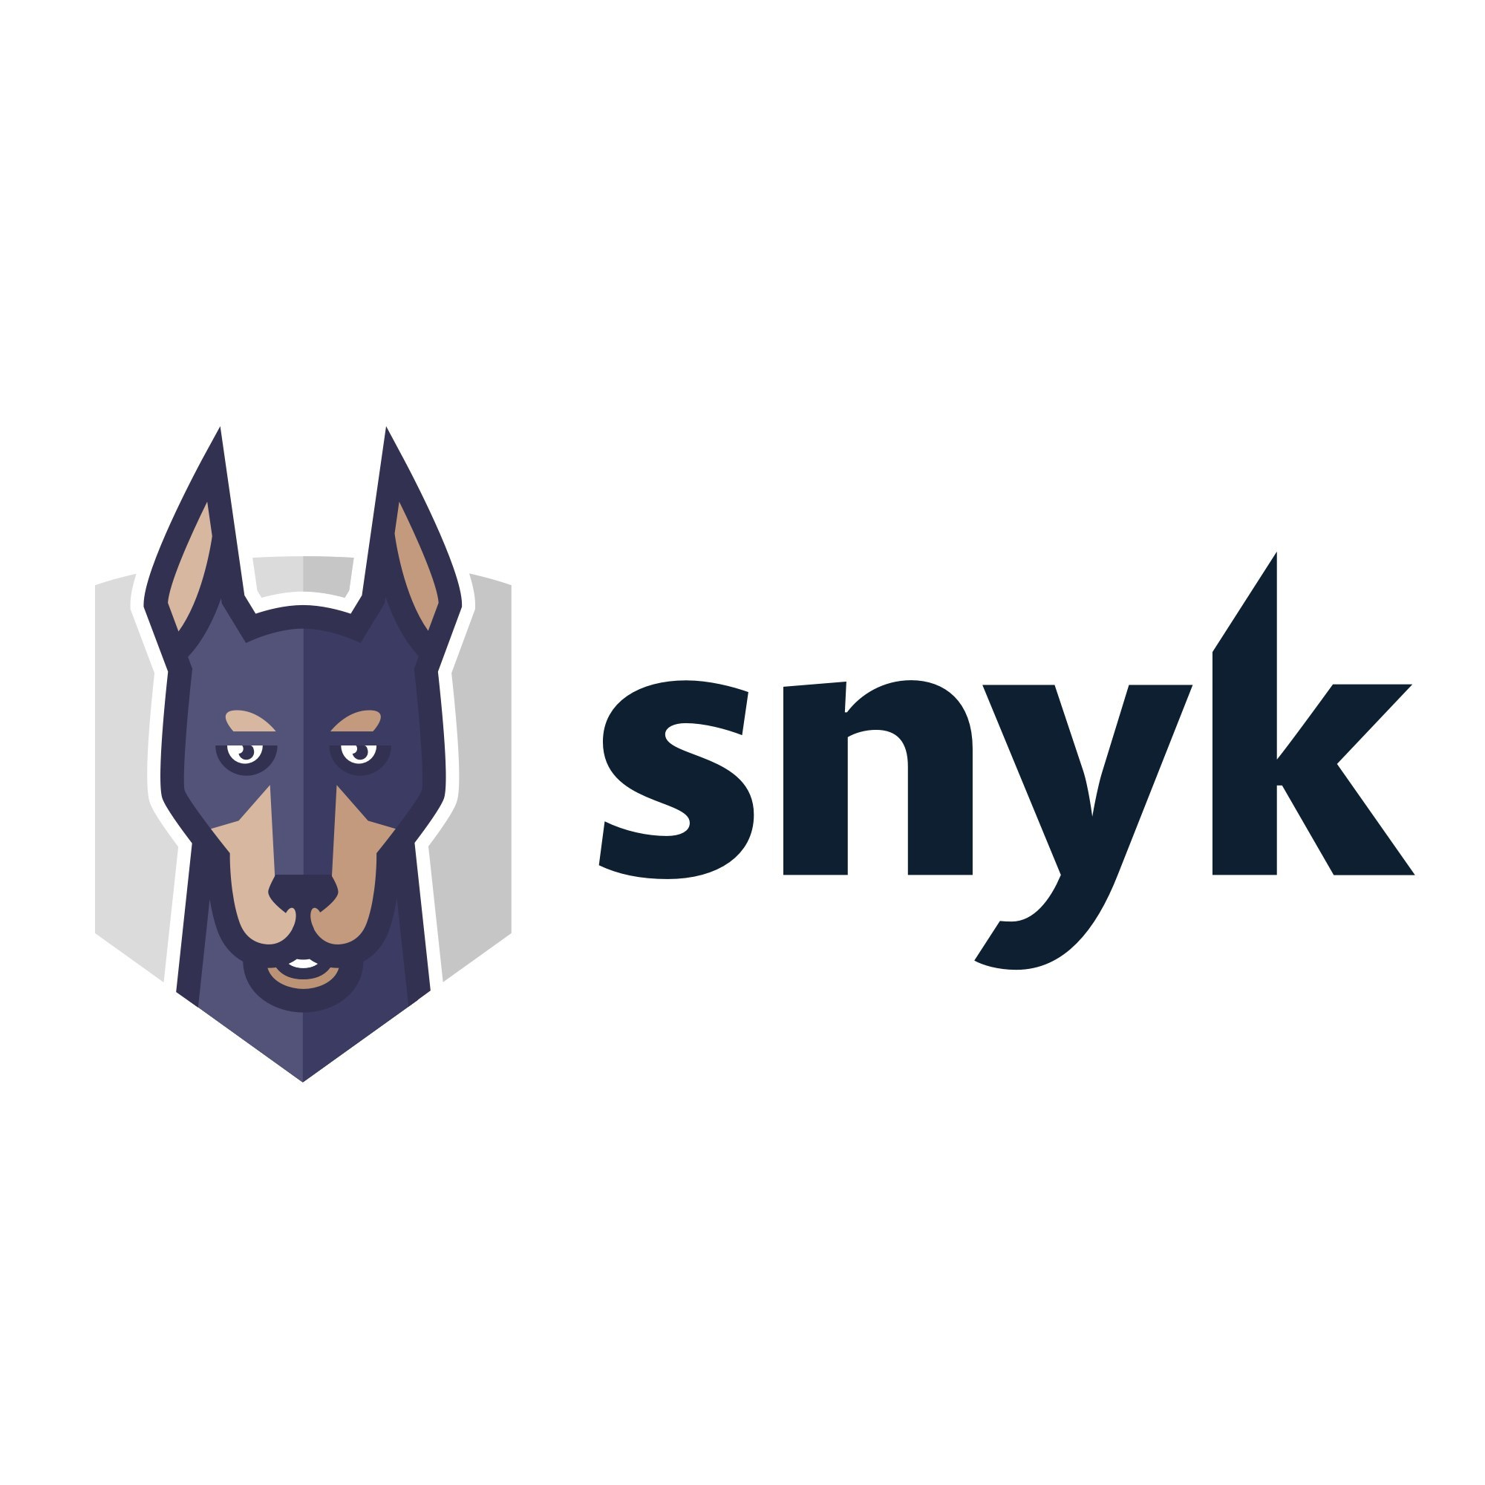

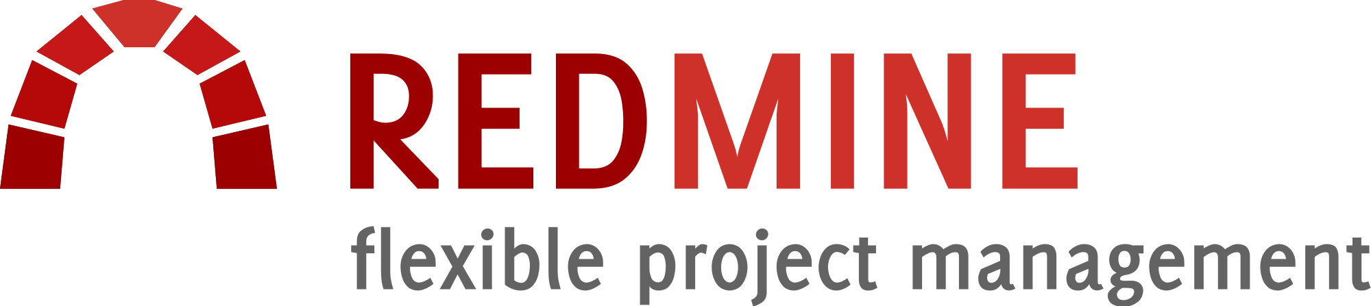
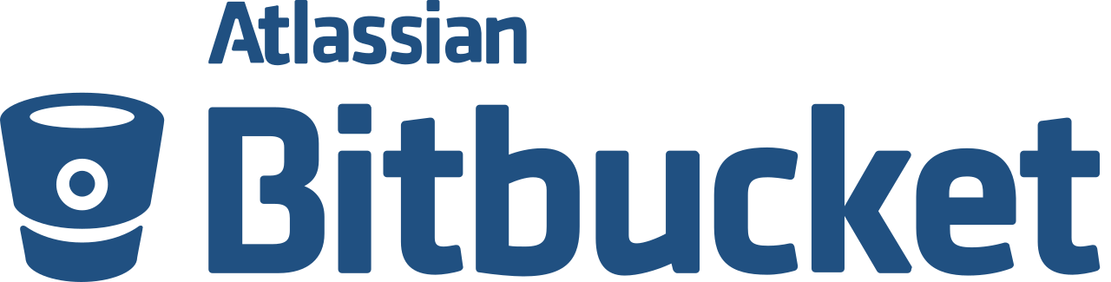

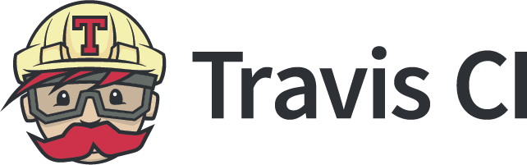

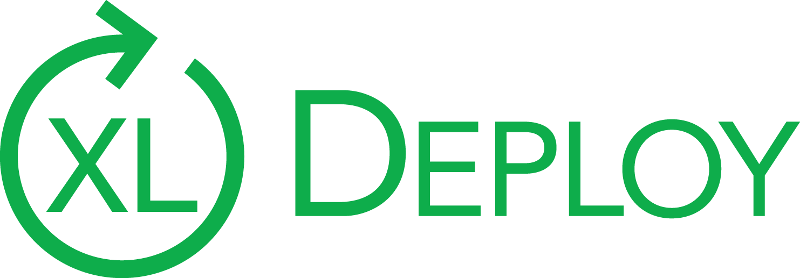
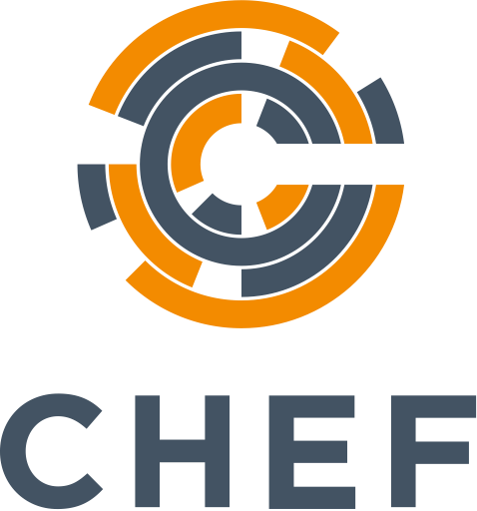


Integration complexity of toolchains slows down teams
Plan
Create
Verify
Package
Release
Configure
Monitor
Secure
Portfolio mgmt
Issue tracking
Version
control
Code
review
Continuous integration
Container registry
CD/Release automation
Configuration Management
Monitoring
Security testing
https://about.gitlab.com/sdlc/#interfaces
Notes:
Here you can see the core stages of the devops lifecycle, you have planning, code creation, all the way through to monitoring. And also shown, are are just some of the tools that can be potentially used at each stage. And this chaining together of tools, comes at the cost of integration complexity.
You need resources to design, build, and maintain the integrations, manage upgrades, and establish HA and DR for each one. They are brittle and can fail.
Setting up a new project, or troubleshooting and optimizing an existing project, becomes difficult and is too slow for todays demands
And the toolchain only serves to reinforce silios that you are trying to break down in the name of DevOps. Instead of teams being able to collaborate together, their different tools put them in indifferent workspaces.

Slide 15


Different teams are using unique set of tools and integrations
The Toolchain Crisis Leads to the DevOps Tool Tax

Slide 16
DevOps ‘tool tax’
Time and cost to acquire all of these tools
Time and cost to integrate all of these tools
User context switching between all of these tools
Notes:
2 second/context switch/developer = 3 hours/context switch for a 6000 dev enterprise.

Slide 17

And it’s getting worse
The shift to microservices
creates an explosion of projects today’s toolchain is not built to handle.
Notes:
As more and more development teams embrace Cloud Native (where applications are built using microservices running in containers), the number of projects proliferates which disparate tool sets were not built for. They were built during the monolithic application era, where releases encompassing a large number of changes were infrequent.

Slide 18
Observability Challenges for microservices
Cloud computing and orchestration enables complexity
This complexity manifests itself as:
Fragmentation
Data explosion
Siloed teams
operational issues
Terrifying MTTR
Observability contains this complexity by providing ways for us to reason about our systems
monolith
microservices

Slide 19






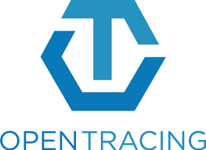
Top Tools in the Ecosystem

Slide 20
The Holy Grail of System Analysis
Logging solution of choice

Slide 21
Prometheus
An open-source monitoring system with a dimensional data model, flexible query language, efficient time series database and modern alerting approach.

Slide 22
Prometheus
Super specialized - only does metrics and does them well
Operationally easy
Low barrier to entry because it is very easy to emit data to create metrics
Extremely scalable for the Enterprise: Designed to handle 10x of the scale that the enterprise users currently have. Fortune 500 companies are happy with single instances. They can do hundreds of thousands of single values per second for time series per instance. 1.5M/sec has been done.

Slide 23
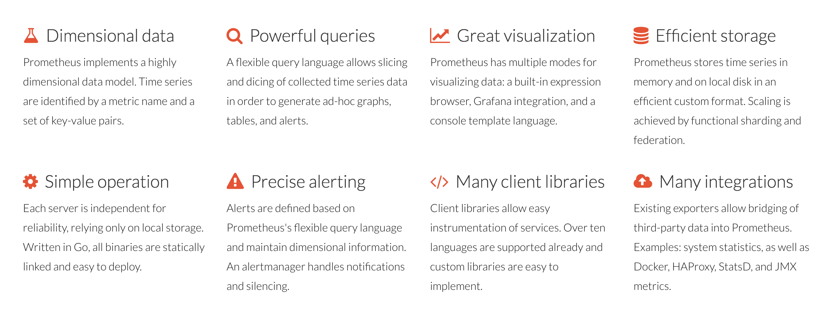
Prometheus: Cool features

Slide 24
Prometheus: Adoption
Digital Ocean, Erikkson, Improbable, SoundCloud, CloudFlare, Red Hat, ING, Fastly, Fitbit, and many more

Slide 25
Prometheus: Complementary
Grafana, GitLab, Pager Duty, Slack
OpenMetrics: Cleaned up, tighter format for Prometheus data with support from industry players … or so I hear. Jury is out currently.

Slide 26
OpenTracing
Vendor-neutral APIs and instrumentation for distributed tracing

Slide 27
OpenTracing
“A vendor-neutral open standard for distributed tracing”
Open Source API
Enables instrumenting existing code with distributed tracing functionality
Does not commit to any implementation (Jaeger, Zipkin, LightStep, etc.)
Bit of History
Google’s Dapper ~2000
Twitter’s Zipkin ~2009
OpenTracing in 2016
Built by industry experts to solve common problem

Slide 28
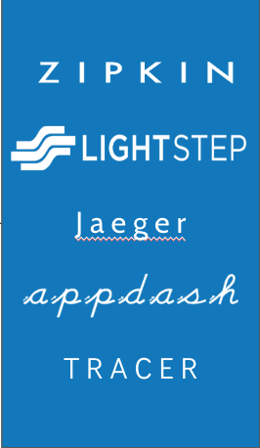
OpenTracing architecture
microservice process
application logic
web frameworks
control-flow packages
main()
J a e g e r
OpenTracing
API
RPC libraries
T R A C E R
Logging and metrics
tracing infrastructure

Slide 29
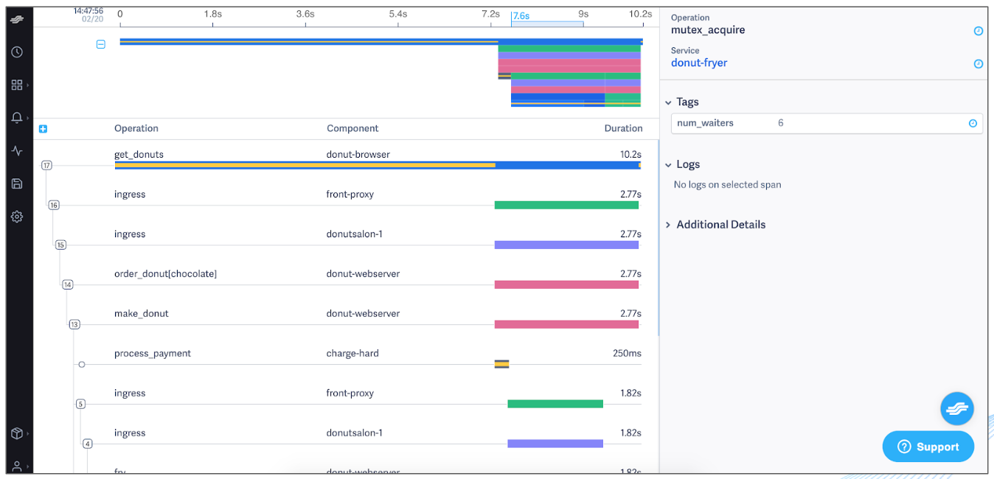
Example trace

Slide 30
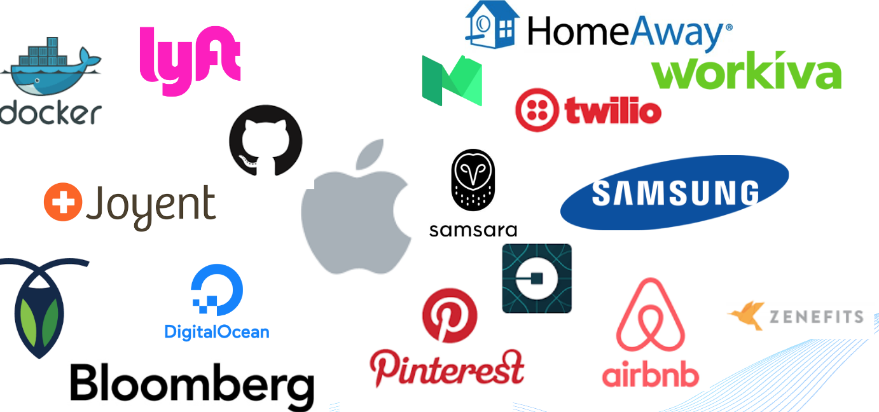
OpenTracing: End-User Adoption

Slide 31
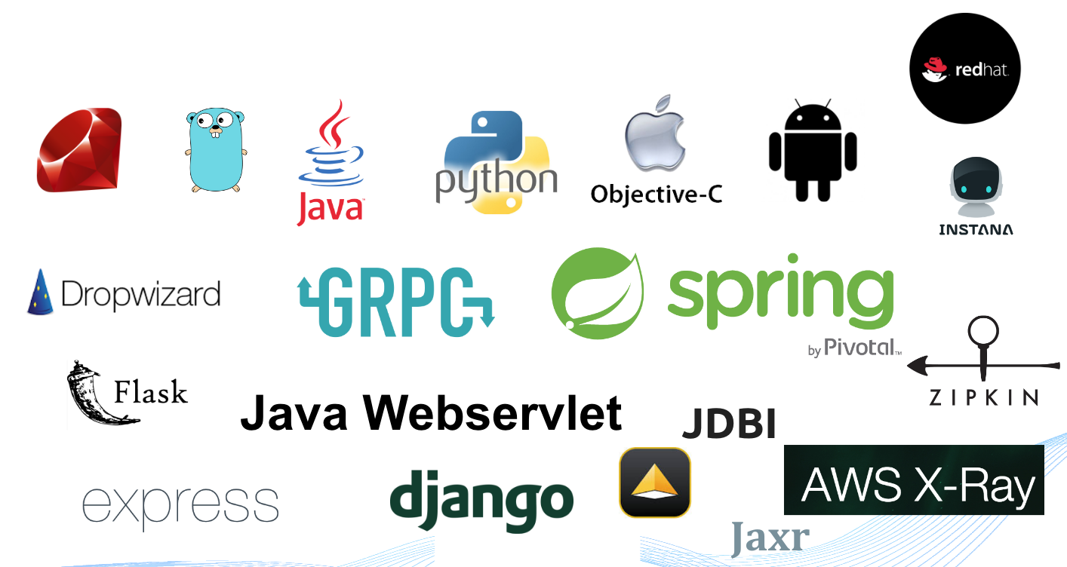
OpenTracing: OSS Adoption

Slide 32
OpenTracing: Complementary
Jaeger, LightStep, Instana, New Relic, DataDog, Grafana, Pager Duty, Slack

Slide 33
GitLab
GitLab is the first single, open core application for software development, security, and operations that enables Concurrent DevOps, making the software lifecycle 200% faster and radically improving the speed of business.

Slide 34
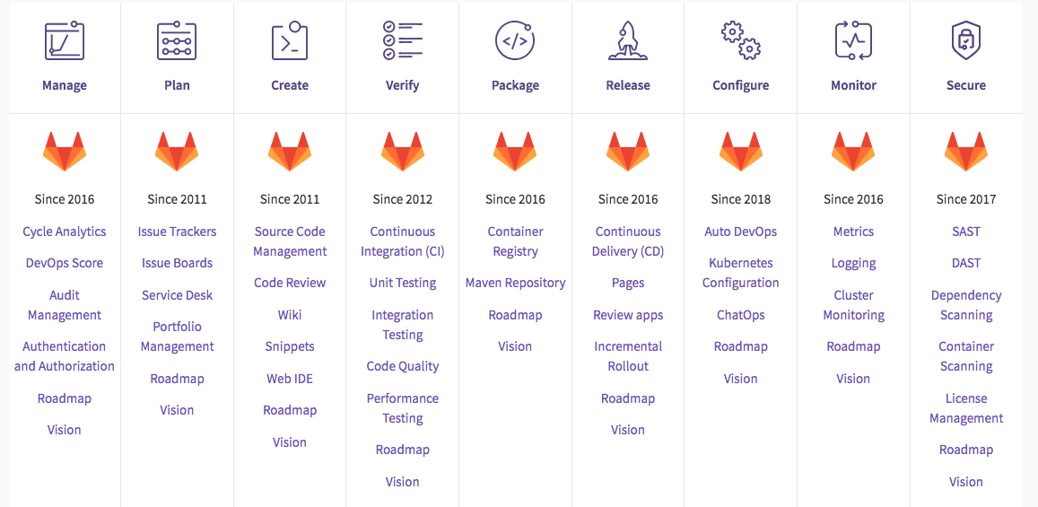
A Single Application Across The Entire DevOps Lifecycle

Slide 35

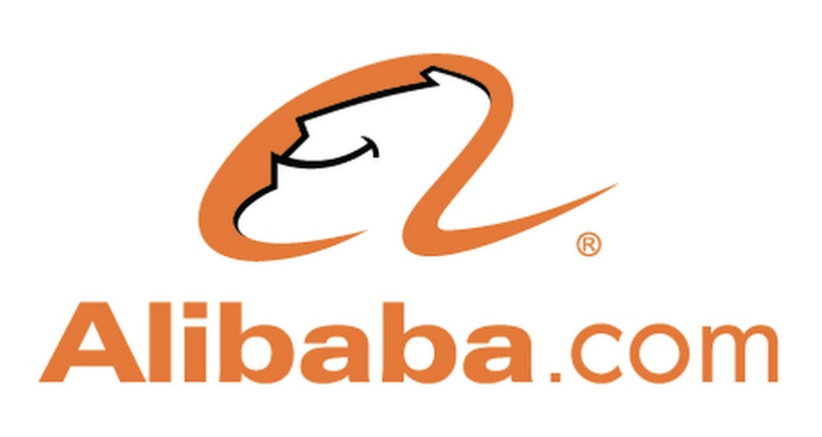
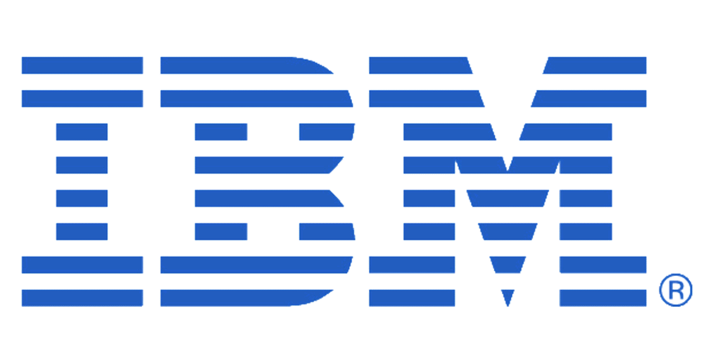




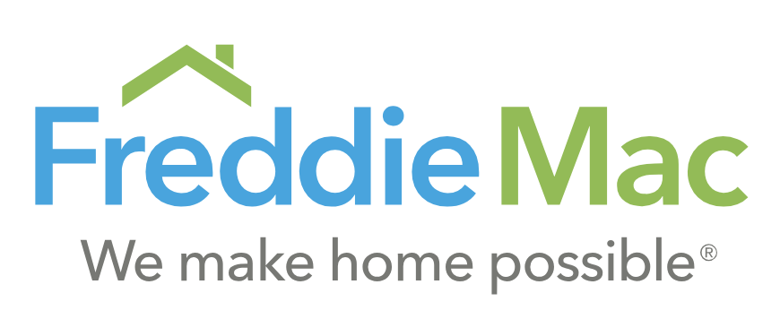





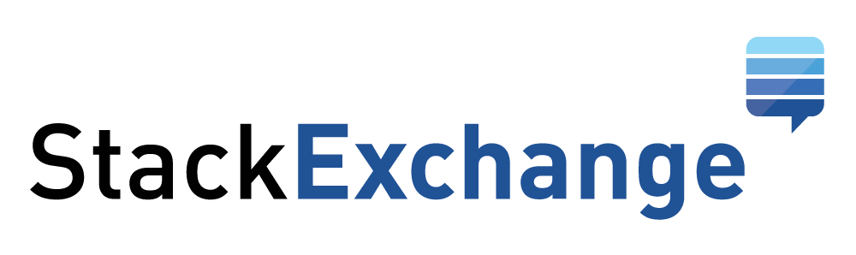
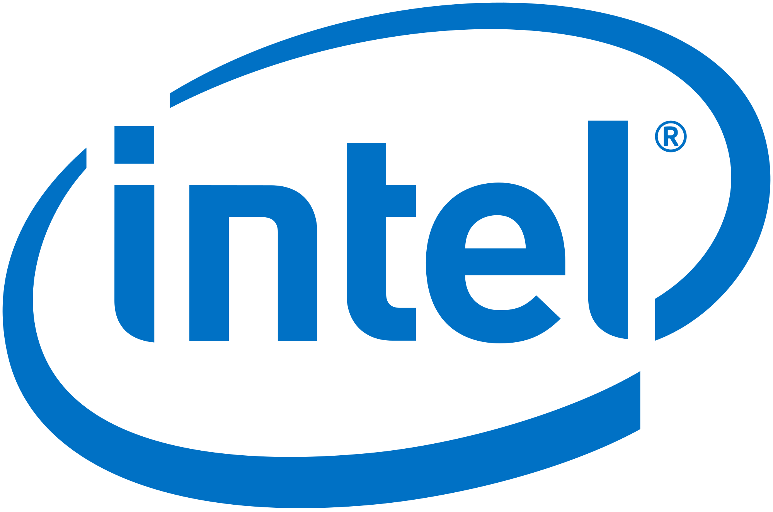
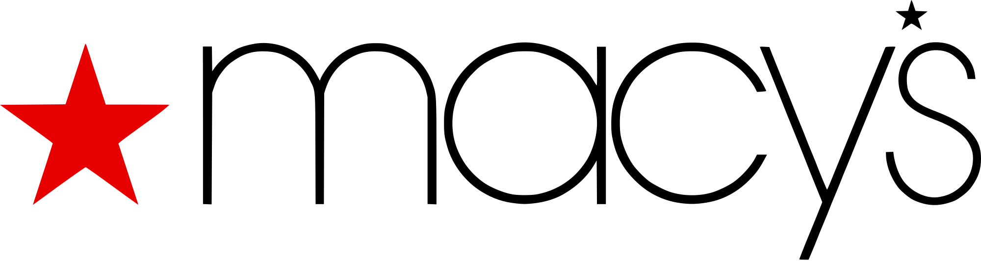
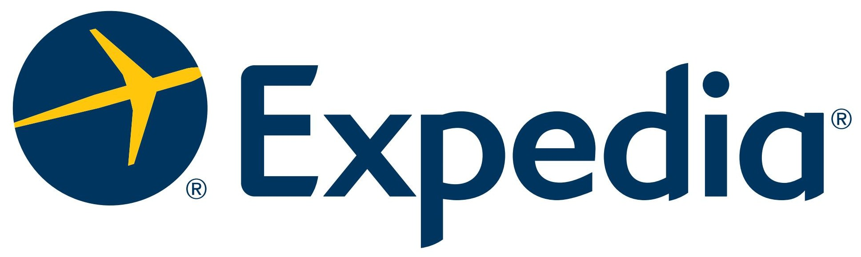
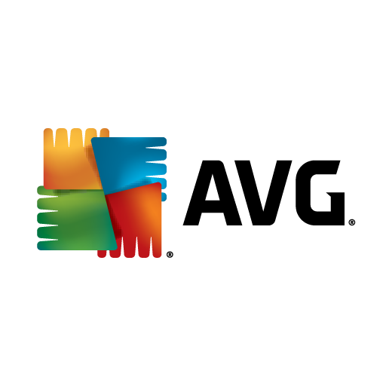



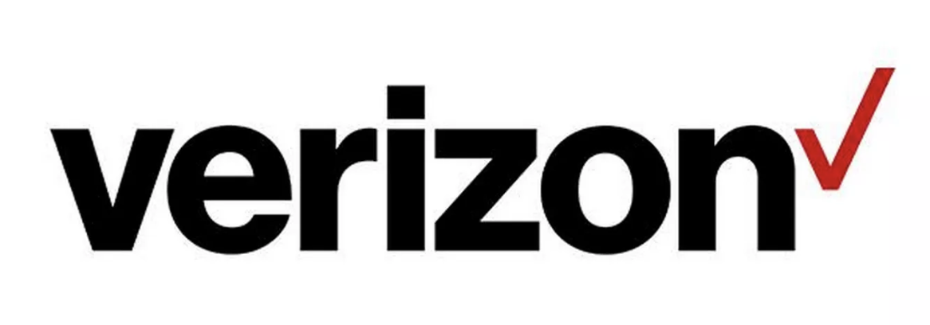

GitLab: End-User adoption
Notes:
We have a broad customer base spanning from tech startups like Uber and Stack Exchange, to large traditional enterprises across a wide range of industries like Macy’s, AT&T, ING and Sony.

Slide 36
GitLab: Complementary
Prometheus, Grafana, Jaeger (coming soon), logging systems of choice, service meshes

Slide 37
Istio
An open platform to connect, monitor, and secure microservices.

Slide 38
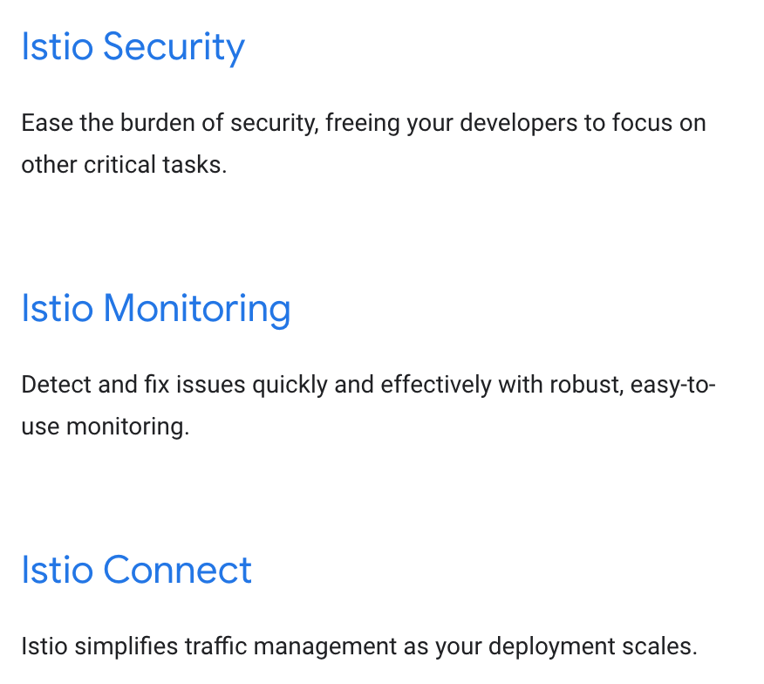
Istio features

Slide 39
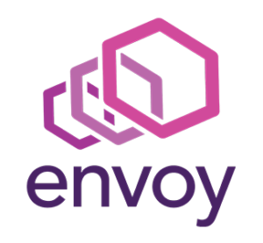
Envoy - baked into Istio
Addresses the core issues of distributed systems:
Networking
Observability
Battle-tested at Lyft
Built upon the learnings from Nginx, HAProxy, hardware load balancers, and cloud load balancers

Slide 40
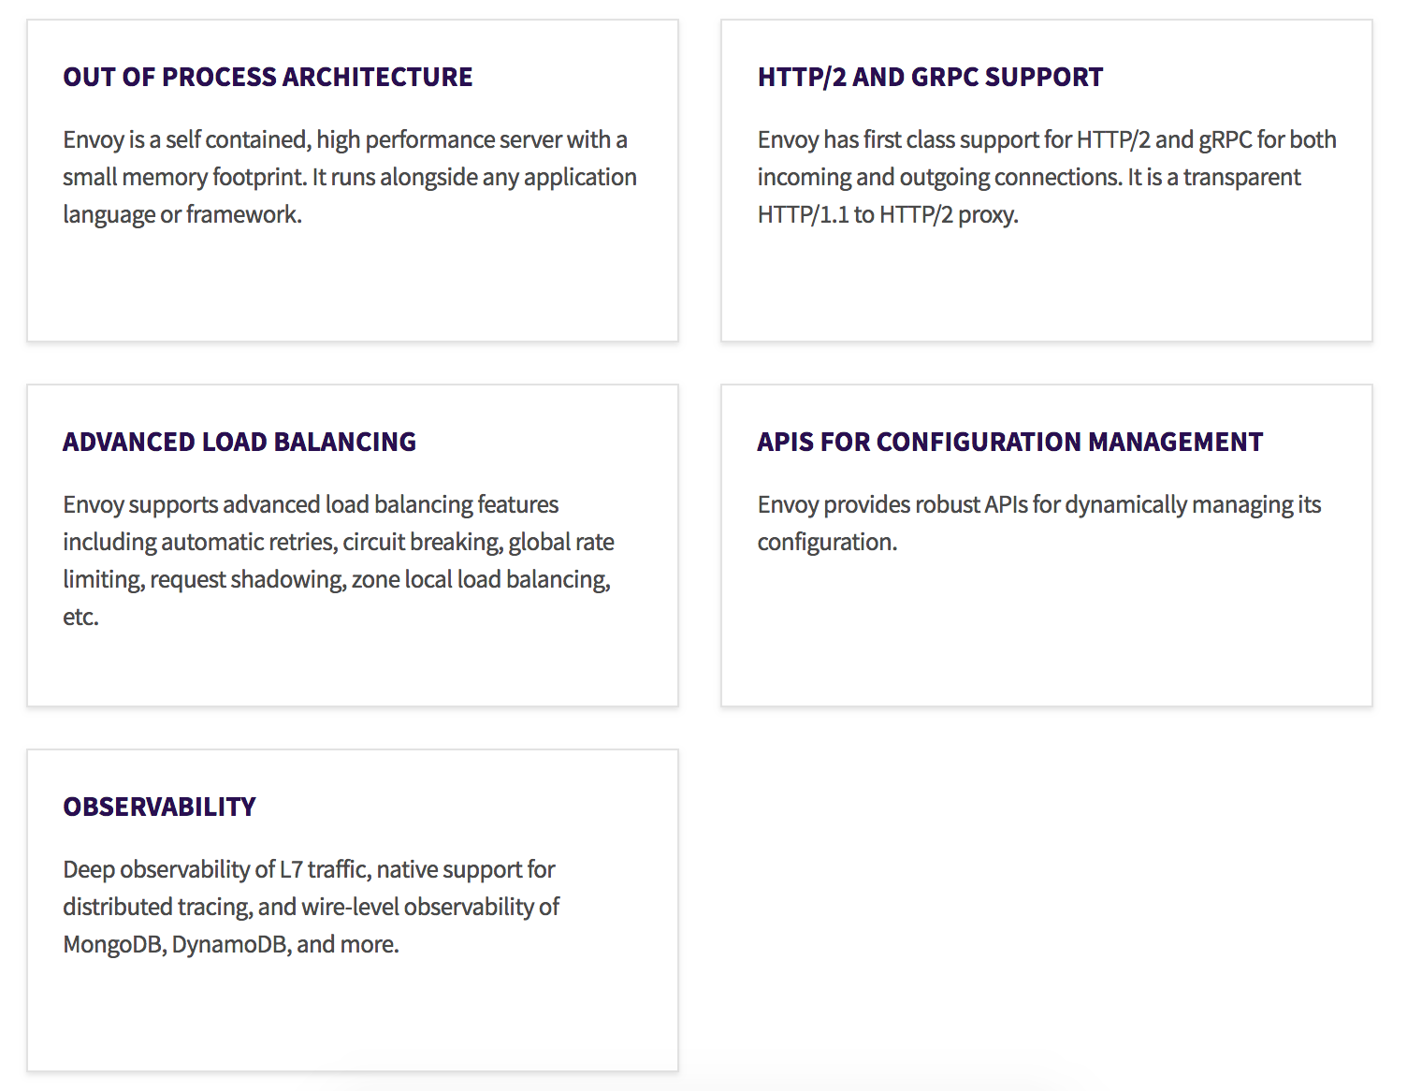
Envoy: Cool Features

Slide 41
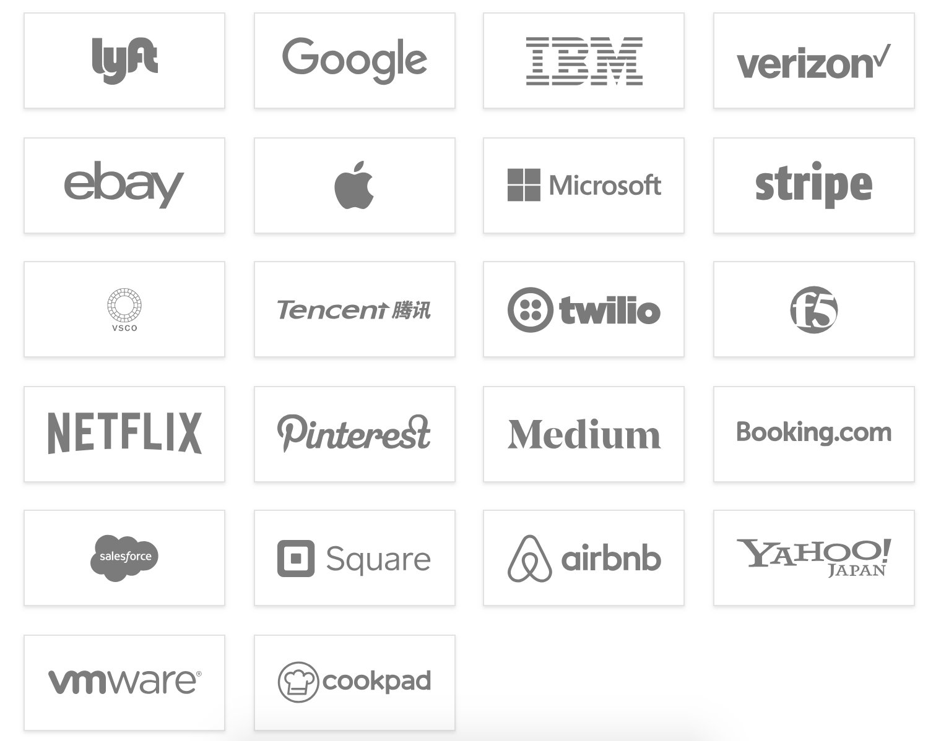
Envoy: Adoption

Slide 42
Envoy: Complementary
OpenTracing, Grafana, GitLab, Pager Duty, Slack

Slide 43
Best Practices for Engineering Leaders

Slide 44
Essential Question
What is your overall workflow?

Slide 45



You need something that is flexible and yet …
VISIBLE
Real time view across the entire lifecycle
EFFICIENT
Collaborate without waiting
GOVERNED
Develop and operate with confidence

Slide 46
The Ideal Workflow

Slide 47
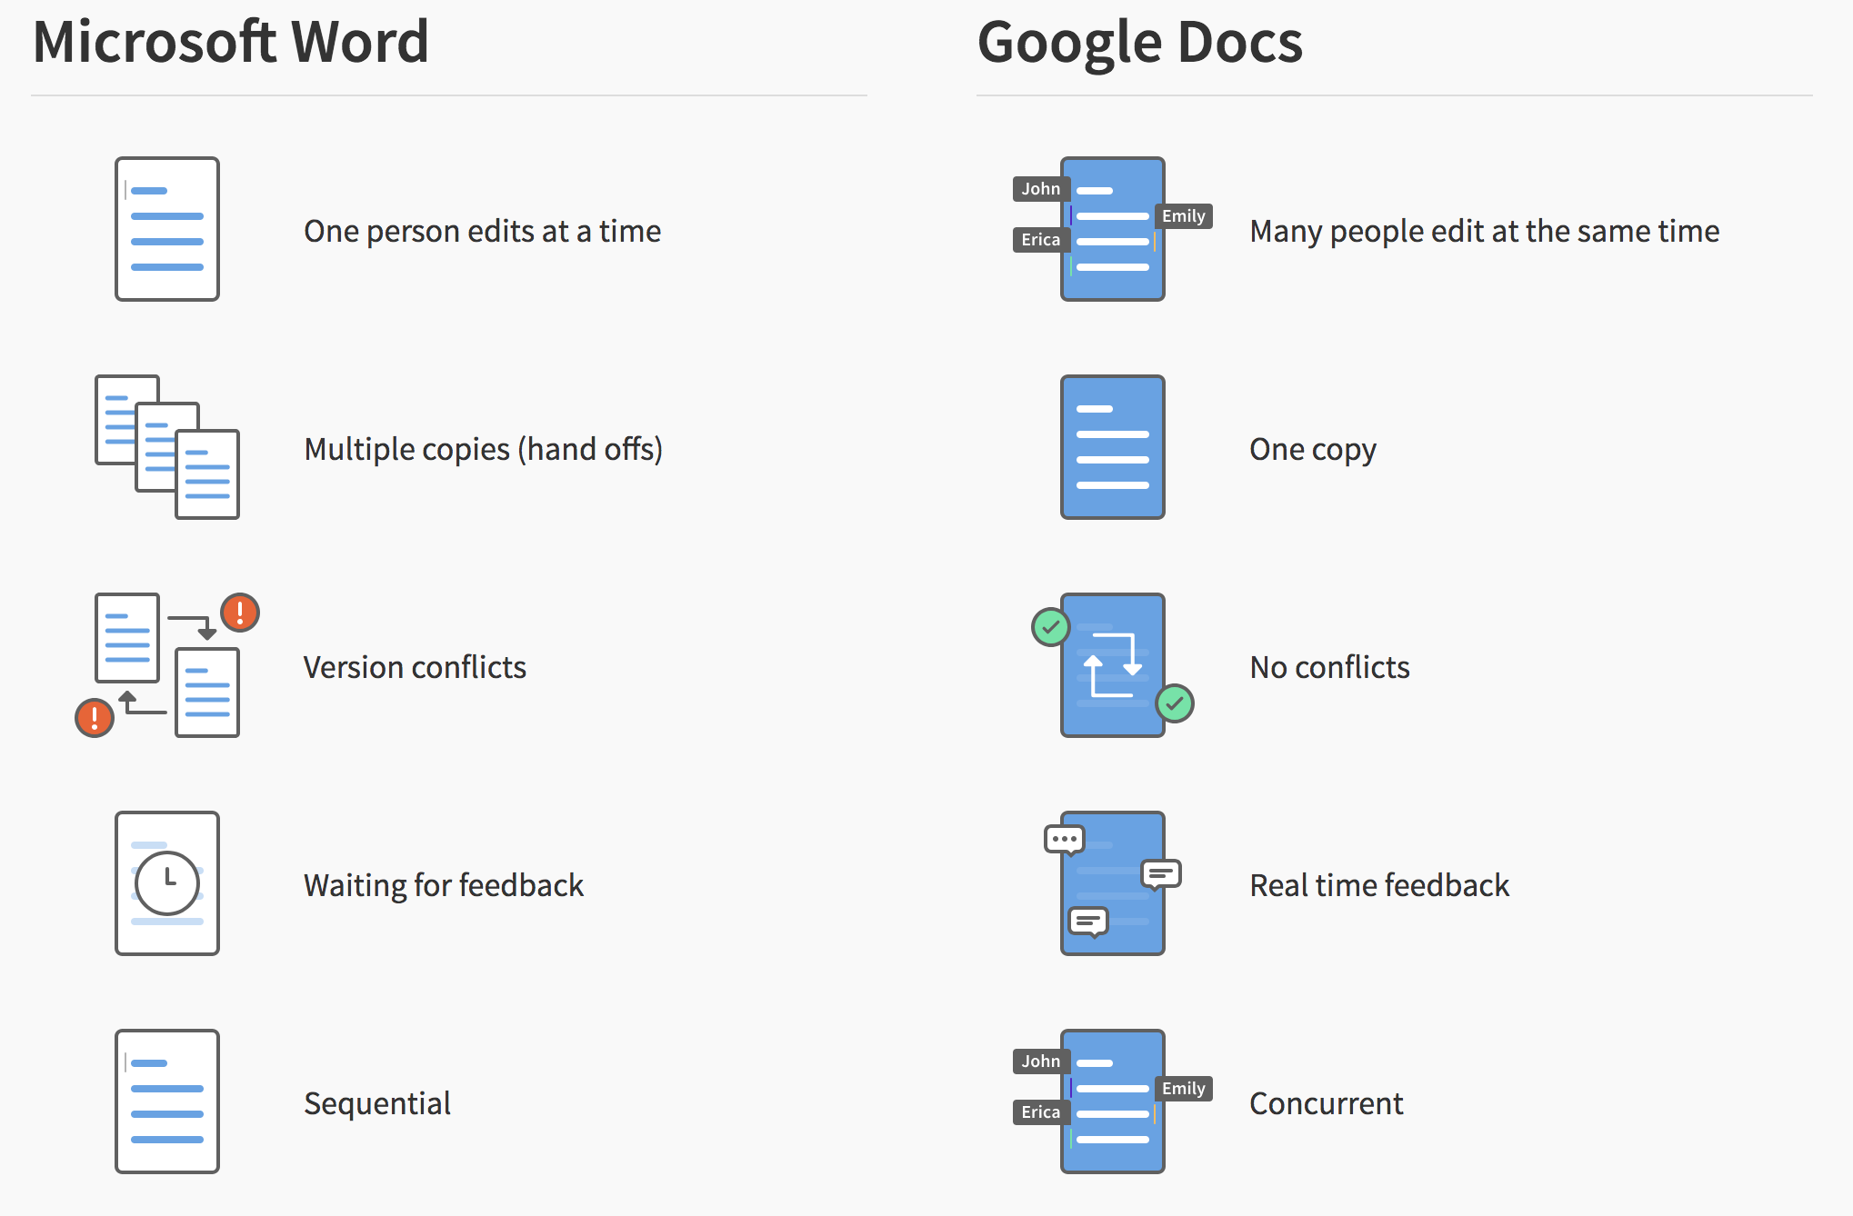
Traditional DevOps toolchain
Notes:
- Opaque… inefficient… uncontrolled…
Instead we think DevOps should be more like Google docs

Slide 48
What could it be like?

Slide 49



GitLab Auto DevOps
Create
Verify
Secure
Package
Release
Configure
Monitor
Merge
Build
Code Quality
Test
SAST
Dependency
Container
License
DAST
Container
Registry
Review App
Deploy
Infra Config
Scale
Response
System
Custom
Perf Testing
You create. Auto DevOps does the rest.
Notes:
These 12 features not only work seamlessly together, but work together automatically, with almost no configuration.
We think that’s the best way to bring these best practices to everyone involved in delivering software.

Slide 50
Defining your observability stack and culture …
Start with the external objective in mind
What have you promised to deliver your customer?

Slide 51
Defining your observability stack and culture …
Waterfall the external objective exercise
What is the objective for each company, organization, department, team, engineer?

Slide 52
Defining your observability stack and culture …
Define what data you need
Use the objectives gathered to identify the data you need

Slide 53
Defining your observability stack and culture …
Instrument for depth, not breadth
Go for the home run, not the test play

Slide 54
Some opinions …
Logs should not be your first stop
Focus on metrics first. If you want to improve or fix thats where traces come in. Logs come in for compliance and when things really go south.

Slide 55
Some opinions …
Don’t overburden humans
Codify alert states and don’t randomly set them up based on (well-meaning) human whims and desires. Humans be expensive.

Slide 56
Some opinions …
A service mesh isn’t for observability
Getting a service mesh is not a substitute for instrumenting your system and connecting the dots between processes. BUT, the more you use a service mesh, the more you need to observe said mesh.

Slide 57
Resources
… because 30 minutes is not enough

Slide 58
Resources
Prometheus: https://prometheus.io/
OpenTracing: http://opentracing.io/
Envoy: https://www.envoyproxy.io/
Istio: https://cloud.google.com/istio
Grafana: https://grafana.com/
GitLab: about.gitlab.com
Blog post: Monitoring and Observability by Cindy Sridharan
Book: The SRE book by Google
Blog post: Bryan Cantrill’s blog

Slide 59
Thank you!
Stay in touch:
@pritianka
psharma@gitlab.com

